Slide 1
Software Design
Rakibul Hassan
Lecturer
Dept. of ECE, RUET

Slide 2
Software Design
Software design is a mechanism to transform user requirements into some suitable form, which helps the programmer in software coding and implementation. It deals with representing the client's requirement, as described in SRS (Software Requirement Specification) document, into a form, i.e., easily implementable using programming language.

Slide 3
Software Design Process
The software design process can be divided into the following three levels of phases of design:
Interface Design
Architectural Design
Detailed Design

Slide 4
Software Design Process
Interface design
Interface design is the specification of the interaction between a system and its environment.
During interface design, the internal of the systems are completely ignored and the system is treated as a black box. Attention is focused on the dialogue between the target system and the users, devices, and other systems with which it interacts.
The design problem statement produced during the problem analysis step should identify the people, other systems, and devices which are collectively called agents.

Slide 5
Software Design Process
Interface design
Interface design should include the following details:
Precise description of events in the environment, or messages from agents to which the system must respond.
Precise description of the events or messages that the system must produce.
Specification on the data, and the formats of the data coming into and going out of the system.
Specification of the ordering and timing relationships between incoming events or messages, and outgoing events or outputs.

Slide 6
Software Design Process
Architectural design
Architectural design is the specification of the major components of a system, their responsibilities, properties, interfaces, and the relationships and interactions between them. In architectural design, the overall structure of the system is chosen, but the internal details of major components are ignored.

Slide 7
Software Design Process
Architectural design
Issues in architectural design includes:
Gross decomposition of the systems into major components.
Allocation of functional responsibilities to components.
Component Interfaces Component scaling and performance properties, resource consumption properties, reliability properties, and so forth.
Communication and interaction between components.

Slide 8
Software Design Process
Detailed Design
Design is the specification of the internal elements of all major system components, their properties, relationships, processing, and often their algorithms and the data structures.

Slide 9
Software Design Process
Detailed Design
The detailed design may include:
Decomposition of major system components into program units.
Allocation of functional responsibilities to units.
User interfaces
Unit states and state changes
Data and control interaction between units
Data packaging and implementation, including issues of scope and visibility of program elements
Algorithms and data structures

Slide 10
Software Design Principles
Software design principles are concerned with providing means to handle the complexity of the design process effectively. Effectively managing the complexity will not only reduce the effort needed for design but can also reduce the scope of introducing errors during design.

Slide 11
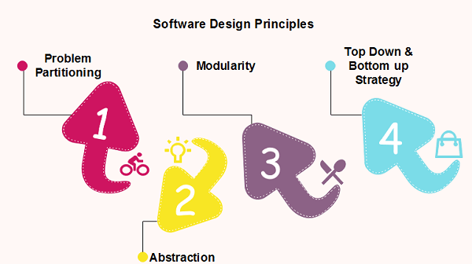
Software Design Principles

Slide 12
Software Design Principles
Problem Partitioning
For small problem, we can handle the entire problem at once but for the significant problem, divide the problems and conquer the problem it means to divide the problem into smaller pieces so that each piece can be captured separately. For software design, the goal is to divide the problem into manageable pieces.

Slide 13
Software Design Principles
Problem Partitioning
Benefits of Problem Partitioning
Software is easy to understand
Software becomes simple
Software is easy to test
Software is easy to modify
Software is easy to maintain
Software is easy to expand

Slide 14
Software Design Principles
Problem Partitioning
These pieces cannot be entirely independent of each other as they together form the system. They have to cooperate and communicate to solve the problem. This communication adds complexity.

Slide 15
Software Design Principles
Abstraction
An abstraction is a tool that enables a designer to consider a component at an abstract level without bothering about the internal details of the implementation. Abstraction can be used for existing element as well as the component being designed. Here, there are two common abstraction mechanisms-
Functional Abstraction
Data Abstraction

Slide 16
Software Design Principles
Abstraction
Functional Abstraction
A module is specified by the method it performs.
The details of the algorithm to accomplish the functions are not visible to the user of the function
Data Abstraction
Details of the data elements are not visible to the users of data. Data Abstraction forms the basis for Object Oriented design
.

Slide 17
Software Design Principles
Modularity
Modularity specifies to the division of software into separate modules which are differently named and addressed and are integrated later on in to obtain the completely functional software. It is the only property that allows a program to be intellectually manageable. Single large programs are difficult to understand and read due to a large number of reference variables, control paths, global variables, etc.

Slide 18
Software Design Principles
Modularity
The desirable properties of a modular system are:
Each module is a well-defined system that can be used with other applications.
Each module has single specified objectives.
Modules can be separately compiled and saved in the library.
Modules should be easier to use than to build.
Modules are simpler from outside than inside

Slide 19
Software Design Principles
Modularity
There are several advantages of Modularity
It allows large programs to be written by several or different people
It encourages the creation of commonly used routines to be placed in the library and used by other programs.
It simplifies the overlay procedure of loading a large program into main storage.
It provides more checkpoints to measure progress.
It provides a framework for complete testing, more accessible to test
It produced the well designed and more readable program.

Slide 20
Software Design Principles
Modularity
There are several disadvantages of Modularity
Execution time maybe, but not certainly, longer
Storage size perhaps, but is not certainly, increased
Compilation and loading time may be longer
Inter-module communication problems may be increased
More linkage required, run-time may be longer, more source lines must be written, and more documentation has to be done

Slide 21
Software Design Principles
Modular Design
Functional Independence
Functional independence is achieved by developing functions that perform only one kind of task and do not excessively interact with other modules. Independence is important because it makes implementation more accessible and faster. The independent modules are easier to maintain, test, and reduce error propagation and can be reused in other programs as well. Thus, functional independence is a good design feature which ensures software quality.

Slide 22
Software Design Principles
Modular Design
Functional Independence
It is measured using two criteria:
Cohesion
Coupling

Slide 23
Software Design Principles
Modular Design
Functional Independence
Cohesion: It measures the relative function strength of a module. Cohesion is a measure that defines the degree of intra-dependability within elements of a module. The greater the cohesion, the better is the program design.
* Types of Cohesion (Self study)

Slide 24
Software Design Principles
Modular Design
Functional Independence
Coupling: It measures the relative interdependence among modules. Coupling is a measure that defines the level of inter-dependability among modules of a program. It tells at what level the modules interfere and interact with each other. The lower the coupling, the better the program.
* Types of coupling (Self study)

Slide 25
Software Design Principles
Modular Design
Information hiding: The fundamental of Information hiding suggests that modules can be characterized by the design decisions that protect from the others, in other words, modules should be specified that data include within a module is inaccessible to other modules that do not need for such information.
The use of information hiding as design criteria for modular system provides the most significant benefits when modifications are required during testing's and later during software maintenance. Inadvertent errors introduced during modifications are less likely to propagate to different locations within the software.

Slide 26
Software Design Principles
Strategy of Design
A good system design strategy is to organize the program modules in such a method that are easy to develop and latter too, change. Structured design methods help developers to deal with the size and complexity of programs. Analysts generate instructions for the developers about how code should be composed and how pieces of code should fit together to form a program. To design a system, there are two possible approaches:
Top-down Approach
Bottom-up Approach

Slide 27
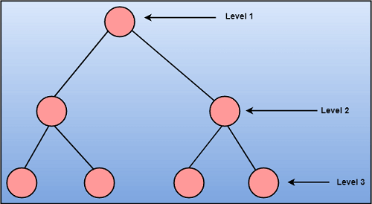
Software Design Principles
Strategy of Design
Top down approach starts with the identification of the main components and then decomposing them into their more detailed sub-components.

Slide 28
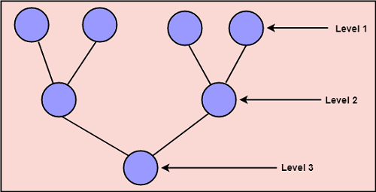
Software Design Principles
Strategy of Design
A bottom-up approach begins with the lower details and moves towards up the hierarchy, as shown in fig. This approach is suitable in case of an existing system.

Slide 29
Thank you

